Slide 1

A serial optical frequency domain imaging study of early and late vascular responses of sirolimus-eluting stent with bioresorbable polymer for treatment of STEMI and stable angina pectoris patients
- Final results of MECHANISM-ULTIMASTER
Yoshihiro Morino, MD, Tomonori Itoh, MD; Takumi Kimura, MD; Yoshiro Tukiyama, MD; Tatsuo Kikuchi, MD; Munenori Okubo, MD; Takatoshi Hayashi, MD; Takayuki Okamura, MD; Shoichi Kuramitsu, MD; Takashi Morita, MD; Toshiro Shinke, MD; Hiromasa Otake, MD, On the behalf of MECHANISM ULTIMASTER Investigators

Slide 2
MECHANISM-ULTIMASTER
Potential conflicts of interest
Speaker's name : Yoshihiro Morino
☑ I have the following potential conflicts of interest to declare:
Participation in a company sponsored speaker's bur: Terumo corporation Receipt of grants / research supports: Terumo corporation

Slide 3
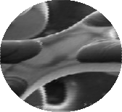
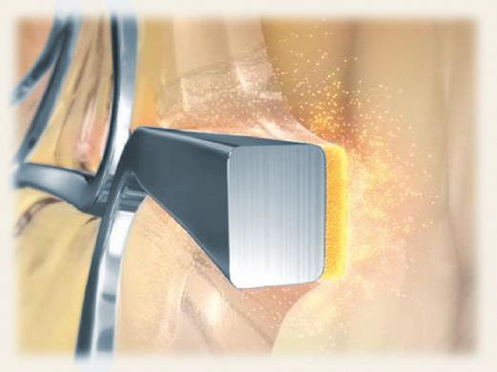
MECHANISM-ULTIMASTER
Backgrounds and Aim
The Ultimaster® stent is a new reduced-dose sirolimus-eluting stent (SES) that uses an abluminal bioresorbable coating on a thin-strut (bioresorbable polymer; BP- SES).
80µm
Coating Thickness=15 µm
Although bioresorbable polymer technology may theoretically promise improved healing of treated segments, clinical trials to characterize their effects on the vessel remain limited.
The time course of early and convalescent vascular healing has not been fully elucidated in ST-
elevation myocardial infarction (STEMI) or stable coronary artery disease (CAD).
Accordingly, the aim of this study was to assess early and late vascular healing in response to BP-SES in the treatment of patients with STEMI and stable CAD using optical frequency domain imaging (OFDI).

Slide 4
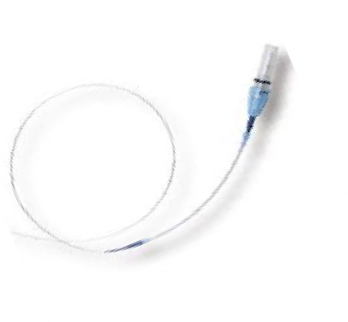
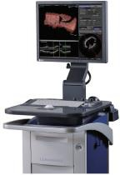
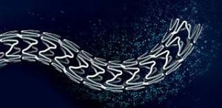
MECHANISM ULTIMASTER
Study outline, Methods, and Analyzable cases
Baseline OFDI 1M OFDI FU 3M OFDI FU 12M OFDI FU
N=50
Index PCI OFDI
n=48
OFDI
analyzable
n=39
OFDI
analyzable
MECHANISM-UM
STEMI
n=106
N=53
Index PCI OFDI
n=51
OFDI
analyzable
n=45
OFDI
analyzable
Withdraw consent: N=3
N=50
Index PCI
OFDI
n=47
OFDI
analyzable
n=42
OFDI
analyzable
MECHANISM-UM
Stable CAD
n=101
N=51
Index PCI
OFDI
n=49
OFDI
analyzable
n=45
OFDI
analyzable
OFDI
Ultimaster
Standard qualitative and quantitative OFDI
parameters (by independent core labo) were compared.
Japanese 21 enrolling sites
implantation

Slide 5
MECHANISM ULTIMASTER
Baseline characteristics
 | STEMI (n=103) | Stable CAD (n=101) | P value
Patient characteristics
Age, yo | 66.2 ± 10.8 | 68.0 ± 9.6 | 0.19
Gender, Male, n (%) | 84 (81.6) | 73 (72.3) | 0.12
Diabetes mellitus, n (%) | 51 (49.5) | 47 (46.5) | 0.67
Dyslipidemia, n (%) | 80 (77.7) | 81 (78.6) | 0.66
Hypertension, n (%) | 71 (68.9) | 81 (78.6) | 0.065
Smoking, n (%) | 64 (62.1) | 46 (45.5) | 0.017
30 ≤ eGFR < 60, eGFR <30, n (%) | 24/1 (23.3/0.97) | 31/1 (31.3/1.0) | 0.49
Peak CK value, IU/L | 180 (36-3520) | 91 (22 – 304) | < 0.001
Lesion and procedural characteristics
LAD, LCX, RCA, n (%) | 28 (27.2) /17(16.5) /58 (56.3) | 73 (36.6)/ 22 (21.8) /42 (41.6) | 0.11
Used stent number, n | 1.21 ± 0.41 | 1.20 ± 0.45 | 0.83
Used stent diameter, mm | 3.23 ± 0.69 | 3.02 ± 0.65 | 0.021
Total stent length, mm | 29.6 ± 13.2 | 30.1 ± 14.3 | 0.83
Final minimal lumen diameter, mm | 2.57 ± 0.45 | 2.58 ± 0.44 | 0.73
Final % diameter stenosis, % | 13.69 ± 7.82 | 11.13 ± 10.13 | 0.051

Slide 6
MECHANISM ULTIMASTER
Results 1: Clinical Outcomes at 12 Months
Incidence of all cause death and cardiac event at 12 Months
 | STEMI (n=103) | Stable CAD (n=101) | HR | P value
All cause death | 2 (1.9) | 1 (1.0) | 1.19 (0.90-1.57) | 0.22
DOCE | 7 (6.8) | 2 (2.0) | 1.25 (0.94-1.66) | 0.12
Cardiac death | 2 (1.9) | 0 (0) | 1.20 (0.91-1.59) | 0.19
Target-vessel MI | 4 (3.9) | 0 (0) | 1.04 (0.79-1.37) | 0.79
Clinically-driven TLR | 5 (4.9) | 2 (2.0) | 1.22 (0.92-1.62) | 0.16
Stent thrombosis | 1 (1.0) | 0 (0) | 1.05 (0.79-1.38) | 0.76

Slide 7
MECHANISM ULTIMASTER
Result 2: %uncovered strut by OFDI (primary endpoint)
(%)
100
STEMI
Stable CAD
STEMI
P<0.001
P=0.002
P trend forward < 0.001
P trend forward < 0.001
80
Repeated ANOVA
p < 0.001: respectively
60
40
P<0.001
P=0.088
20
P=0.12
P=0.025
0
post
1M
12M
post
3M
12M
STEMI (%)
68.01 ± 17.88
19.27 ± 11.73
1.11 ± 1.73
61.55 ± 18.69
10.07 ± 7.23
1.40 ± 2.12
Stable CAD (%)
78.39 ± 18.61
9.04 ± 8.17
0.66 ± 1.16
79.62 ± 14.14
8.11 ± 7.66
0.66 ± 1.16

Slide 8
MECHANISM ULTIMASTER
Result3 : Average In-stent Tissue Thickness by OFDI
(μm)
250
STEMI
Stable CAD
Repeated ANOVA
p < 0.001: respectively
P trend forward < 0.001
P=0.99
P trend forward < 0.001
200
P=0.43
150
P=0.055
100
P=0.78
P<0.001
P<0.001
50
0
Post
1M
12M
Post
3M
12M
STEMI(um) | 25.58 ± 24.28 | 50.01 ± 22.16 | 178.01 ± 79.26
Stable CAD(um) | 11.44 ± 16.24 | 48.95 ± 176.89 | 176.89 ± 74.35
34.87 ± 30.74 | 66.34 ± 31.71 | 153.60 ± 56.73
9.80 ± 10.17 | 52.71 ± 18.34 | 147.95 ± 63.14

Slide 9
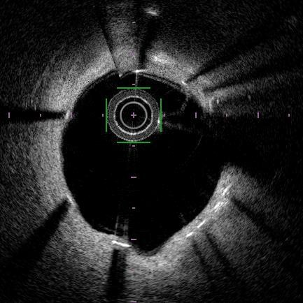
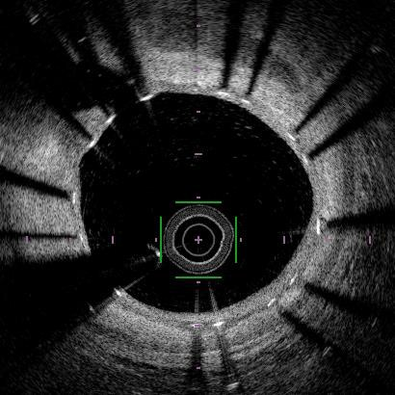
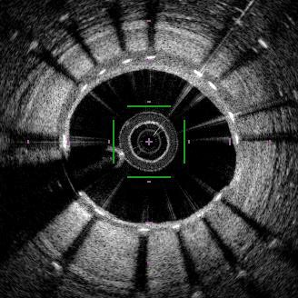
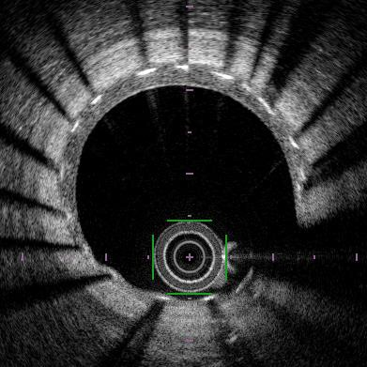
Result 4: Serial Changes of Peri-strut low-intensity area (PLIA) score
: Surrrogate marker of immature neointima or peri-strut inflammation
Grade 1 – only around the struts
Grade 2 – in part of the neointima
Grade 3 in the entire neointima (most immature)
Grade 0 – no PLIA
<
<
<
STEMI
Stable
CAD
(%)
80
1-month
(%)
80
3-month
(%)
80
12-month
AMI vs. Stable CAD P<0.001
AMI vs. Stable CAD P<0.001
AMI vs. Stable CAD P=0.001
60
60
60
40
40
40
20
20
20
0
0
0
0
1
2
3
0
1
2
3
0
1
2
3

Slide 10
MECHANISM ULTIMASTER
Summary of Novel Findings and Conclusions
Although the strut-coverage in the early-phase after BP-SES implantation were slightly delayed in STEMI patients compared to stable-CAD patients, those differences diminished over time, almost disappearing by 12 months.
The average neointimal thickness of the two cohorts were comparable at 12 months.
Elevated PLIA scores, considered a sign of immature neointima or peri-strut inflammation, were observed in the early phases but significantly improved in both cohorts within 12 months.
In conclusion, owing to the combination of these multifactorial improvements, qualitatively and quantitatively consistent neointimal stent coverage was achieved by the 12-month timepoint in both pathogenetic groups following BP-SES implantation, suggesting long-term lesion stability of this bioresorbable polymer technology.

